Slide 1
Exploratory Data Analysis (EDA) for Real Estate Pricing: Unveiling the Dynamics of House Valuation in a Dynamic Market
Present By
Shivam Kesharwani

Slide 2
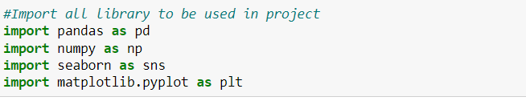
Import the important Libraries

Slide 3
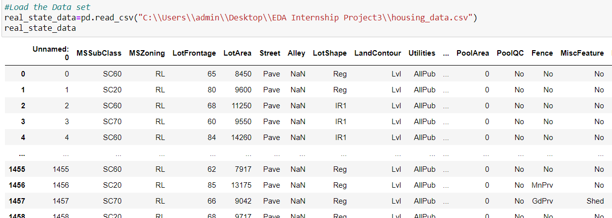
Load the Data Set

Slide 4
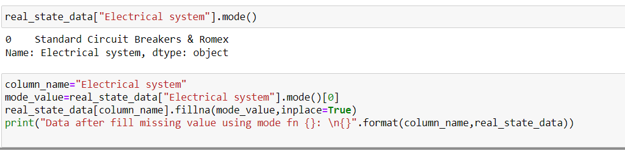
Cleaning the Data

Slide 5
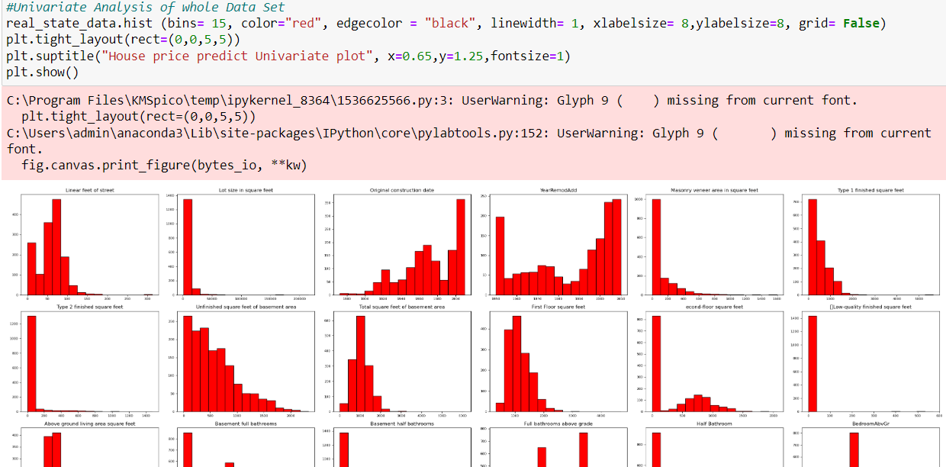
Univariate Analysis

Slide 6
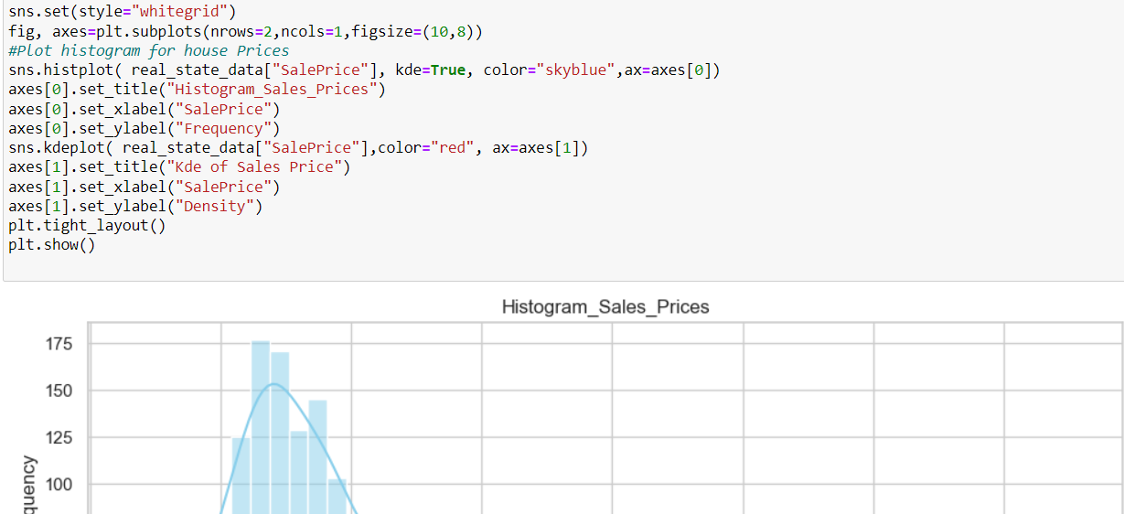
Univariate Analysis

Slide 7
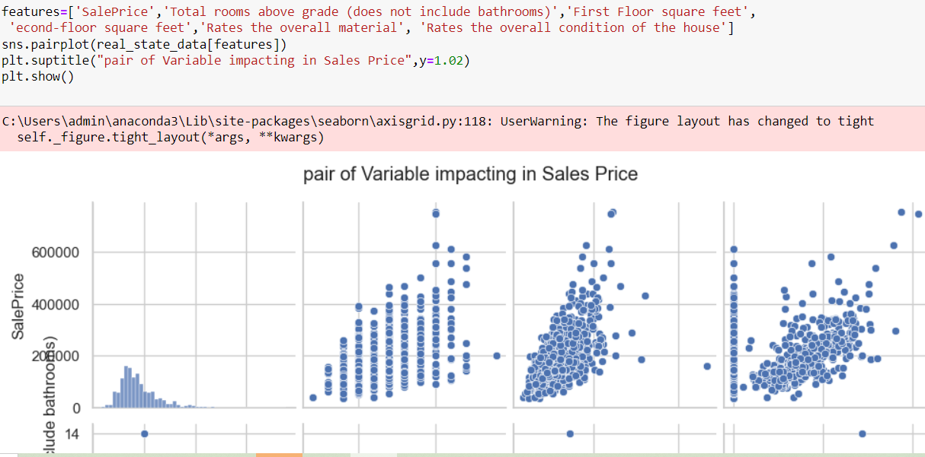
Multivariate Analysis

Slide 8
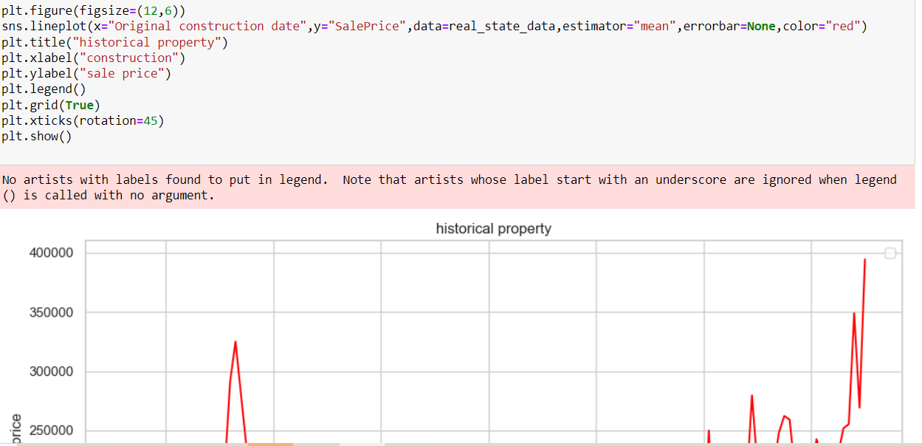
Market Trends and Historical Pricing

Slide 9
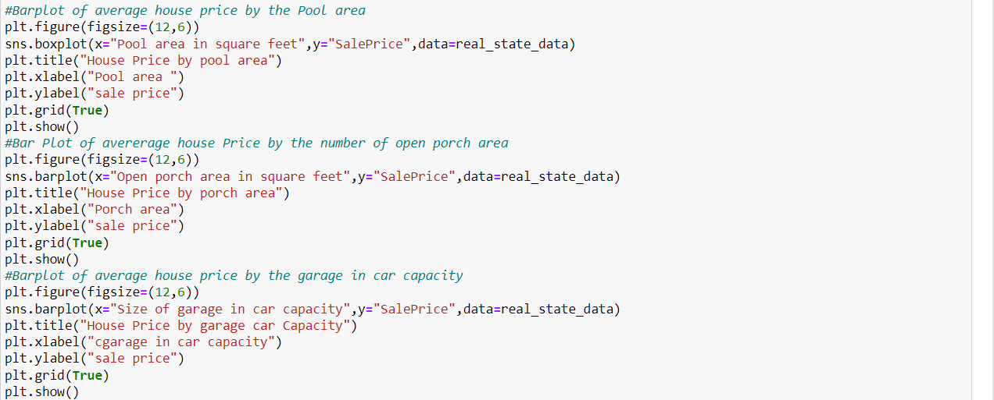
Customer Preferences and Amenities

Slide 10
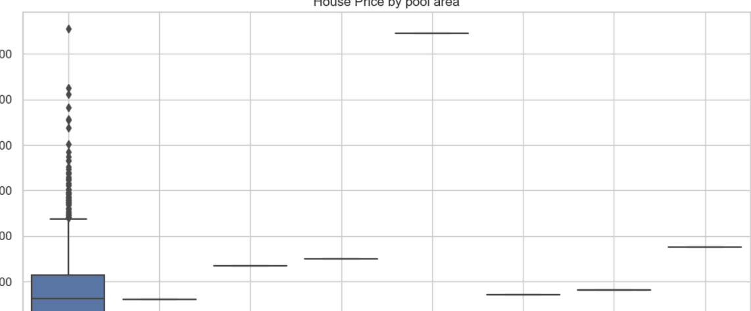
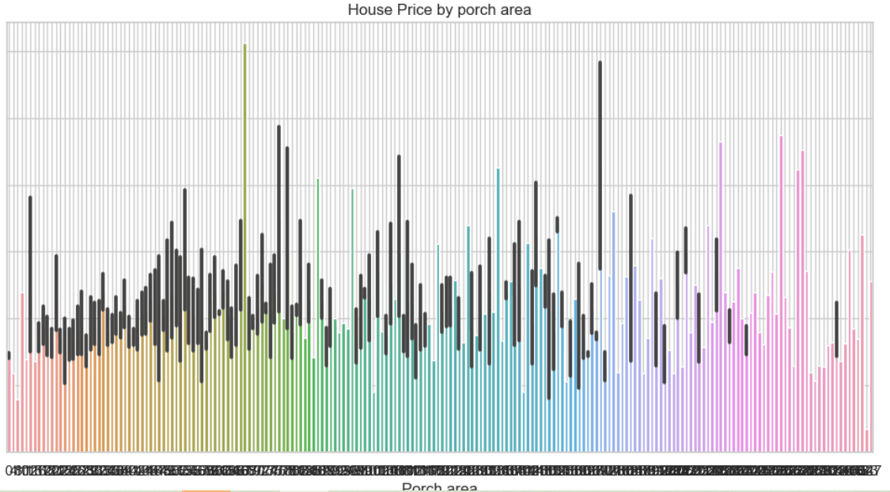
Find the best Option
Choose According to Pool area
Choose According to porch area

Slide 11
Thank you

